Slide 1




EMBARGOED for 9am ET 11/17/19
Effects of Acute Colchicine Administration Prior to Percutaneous Coronary Intervention: The COLCHICINE-PCI Randomized Trial
Binita Shah, MD, MS on behalf of the COLCHICINE-PCI investigators
Associate Director of Research, Cardiac Cath Lab
Assistant Professor of Medicine
VA New York Harbor Healthcare System, Manhattan Campus
NYU School of Medicine
Funding Sources: VA Career Development Award (iK2CX001074), American Heart Association Clinical Research Mentored grant (13CRP14520000); drug was supplied by Takeda Pharmaceuticals and the Manhattan VA Hospital Research Pharmacy.

Slide 2
Background
Vascular injury and inflammation during percutaneous coronary intervention (PCI):
  Induces rapid neutrophil recruitment to the site of mechanical trauma
  Is associated with endothelial cell and microvascular dysfunction
  Is an independent predictor of subsequent major adverse cardiovascular events (MACE) even in the contemporary era of second-generation drug-eluting stents
CANTOS demonstrated a reduction in recurrent MACE after myocardial infarction (MI) with anti-interleukin (IL)-1β antibody
#AHA19

Slide 3

Colchicine
Inhibits neutrophil chemotaxis and activity in response to vascular injury
Inhibits inflammasome signaling and reduces the production of active IL-1β
Reduces neutrophil-platelet interaction and aggregation
The standard regimen of colchicine used for gout flares (1.2 mg PO followed by 0.6 mg PO administered over an hour) has rapid onset of anti-inflammatory effects
#AHA19

Slide 4
Hypothesis
An acute, pre-procedural oral administration of 1.8 mg of colchicine reduces biomarker evidence of PCI-related inflammation and myocardial injury when compared with placebo.
#AHA19

Slide 5
Patient Population
Adults with suspected ischemic heart disease or acute coronary syndromes referred for clinically-indicated coronary angiography with possible PCI
Key exclusion criteria
  Use of oral steroids or NSAIDs
  New high-intensity statin <24 hours prior to randomization
  GFR <30 mL/min or on dialysis
  Use of strong CYP3A4/P-glycoprotein inhibitor
  Use of colchicine
#AHA19

Slide 6
Trial Design
Investigator-initiated, randomized, double-blind, placebo-controlled, single-center trial with a nested inflammatory biomarker substudy
Colchicine 1.2mg
1 hour
Colchicine 0.6mg
Baseline Assessment (immediately prior to drug)
1 hour
post-PCI
6 to 8 hours
post-PCI
22 to 24 hours
post-PCI
30-day
Follow-up
Randomization
(1-2 hrs pre-cath)
PCI
Will follow out to 5 yrs
Placebo 1.2mg
1 hour
Placebo 0.6mg
Troponin
Clinical Assessment for MACE
Inflammatory biomarkers
#AHA19

Slide 7
COLCHICINE-PCI Study Outcomes
Primary outcome
  PCI-related myocardial injury (Universal Definition)
    Normal baseline cardiac biomarker: Troponin I above the upper reference limit (URL)
    Elevated baseline cardiac biomarker but falling: Increase in Troponin I by >20%
Key secondary outcomes
  Composite of death from any cause, non-fatal myocardial infarction (MI), or target vessel revascularization at 30 days
    Non-fatal MI was defined as type 1 or type 4a (Tn >5x URL) MI per the Universal Definition
  PCI-related MI as defined by the Society for Cardiovascular Angiography and Interventions (Tn >70x URL)
#AHA19

Slide 8
Inflammatory Biomarker Substudy Endpoints
Primary endpoint
  Between group difference in the change in plasma IL-6 concentration from baseline to 1 hour post-PCI
Secondary endpoints
  Change in plasma IL-6 concentration from baseline to 6 and 24 hours post-PCI
  Change in plasma IL-1β concentration from baseline to 1, 6, and 24 hours post-PCI
  Change in hsCRP concentration from baseline to 24 hours post-PCI
#AHA19

Slide 9
Statistics
COLCHICINE-PCI
  Sample size of 400 subjects who undergo PCI to provide 80% power to detect 40% relative risk reduction in the primary outcome
  Outcomes compared between groups using chi-square test
Inflammatory biomarker substudy
  258 subjects to provide 80% power to detect a 35% relative reduction in the substudy primary endpoint → increased to 280 subjects a priori to adjust for a possible floor effect
  Differences in the percent change in biomarkers from baseline to post-PCI were compared using the Mann-Whitney test
  Sensitivity analysis was performed using a linear mixed model analysis
Significance was set at a two-sided alpha level of 0.05
#AHA19

Slide 10
Enrollment
1453 patients referred for coronary angiography with possible PCI screened
549 (38%) Excluded:
129 (23%) Use of oral steroids or NSAIDs
124 (23%) High-intensity statin load <24 hrs pre-procedure
86 (16%) GFR <30mL/minute or on dialysis
37 (7%) Strong CYP3A4/P-glycoprotein inhibitors
34 (6%) Chronic colchicine use
20 (4%) Active malignancy or infection
1 (0.2%) History of myelodysplasia
66 (12%) Enrolled in a competing study
36 (7%) Unable to consent
16 (3%) Other
#AHA19

Slide 11
Enrollment (continued)
1453 patients referred for coronary angiography with possible PCI screened
549 (38%) Excluded
904 (62%) patients approached for enrollment
190 (21%) Not enrolled:
169 (19%) Declined participation
14 (1.5%) Procedure was cancelled for clinical reasons
7 (0.8%) Unable to draw blood at baseline
#AHA19

Slide 12
1453 patients referred for coronary angiography with possible percutaneous coronary intervention (PCI) screened
549 (38%) Excluded
904 (62%) patients approached for enrollment
190 (21%) Not enrolled
714 (79%) study subjects
Randomized to Colchicine Group
(n=366)
Randomized to Placebo Group
(n=348)
160 (44%) subjects underwent diagnostic coronary angiography only
154 (44%) subjects underwent diagnostic coronary angiography only
206 (56%)
subjects underwent PCI
194 (56%)
subjects underwent PCI
#AHA19

Slide 13
Baseline Characteristics
 | Colchicine (n=206) | Placebo (n=194) | p-value
Age, years | 65.9 + 9.9 | 66.6 + 10.2 | 0.54
Male sex, % | 93.7 | 93.3 | 0.99
Race, % |  |  | 0.28
White | 77.2 | 74.2
Black | 19.9 | 19.1
Asian | 2.4 | 6.2
Hispanic ethnicity, % | 20.4 | 22.2 | 0.76
Hypertension, % | 93.2 | 90.2 | 0.36
Dyslipidemia, % | 88.3 | 89.2 | 0.92
Diabetes mellitus, % | 55.3 | 60.3 | 0.37
Prior myocardial infarction, % | 24.8 | 26.8 | 0.72
Renal insufficiency, % | 21.8 | 19.6 | 0.67
Current tobacco use, % | 20.9 | 23.7 | 0.57
Acute coronary syndrome, % | 50.0 | 49.0 | 0.92
Abnormal troponin at baseline, % | 31.1 | 27.3 | 0.48
#AHA19

Slide 14
Coronary and Procedural Characteristics
 | Colchicine (n=206) | Placebo (n=194) | p-value
Multivessel coronary artery disease, % | 55.8 | 53.1 | 0.65
Left main disease, % | 2.4 | 3.1 | 0.92
LAD artery, % | 72.8 | 70.1 | 0.62
Circumflex artery disease, % | 50.5 | 50.5 | 0.99
Right coronary artery disease, % | 49.0 | 54.6 | 0.31
Total stent length, mm | 28 [18, 38] | 28 [18, 38] | 0.79
Number of inflations | 6 [4, 8] | 6 [4, 8] | 0.68
Any intra-procedural complication (e.g., abrupt closure, major dissection), % | 3.9 | 5.2 | 0.71
#AHA19

Slide 15
Lesion Level Characteristics
 | Colchicine (n=258) | Placebo (n=242) | p-value
Pre-procedural TIMI 0/1 flow, % | 5.0 | 7.9 | 0.95
Stent diameter, mm² | 3.00 [2.50, 3.00] | 2.75 [2.50, 3.00] | 0.59
Maximum pressure on last device, atm | 20 + 4 | 20 + 5 | 0.65
Bifurcation, % | 15.5 | 14.9 | 0.89
Heavily calcified, % | 13.6 | 18.6 | 0.63
Tortuous, % | 6.6 | 10.3 | 0.74
Chronic total occlusion, % | 5.4 | 4.5 | 0.86
Lesion length >33 mm, % | 22.1 | 21.5 | 0.77
Thrombus, % | 4.7 | 3.7 | 0.91
Re-stenosis, % | 6.2 | 4.5 | 0.82
#AHA19

Slide 16
Primary Outcome
PCI-Related Myocardial Injury (%)
(Universal Definition)
p=0.19
#AHA19

Slide 17
Primary Outcome
PCI-Related Myocardial Injury (%)
(Universal Definition)
p=0.19
66
(34.7%)
62
(30.1%)
56
(27.2%)
56
(29.5%)
#AHA19

Slide 18
Key Secondary Outcomes
 | Colchicine (n=206) | Placebo (n=194) | p-value
30-day MACE
Type 4a MI (Universal) | 23 (11.2) | 23 (12.1) | 0.89
Type 1 MI (Universal) | 0 | 1 (0.5) | 0.49
TVR | 0 | 0 | --
All-cause mortality | 1 (0.5) | 1 (0.5) | 0.99
p=0.71
30-Day Major Adverse Cardiovascular Events (%)
p=0.82
 | Colchicine (n=206) | Placebo (n=194) | p-value
PCI-related MI (SCAI) | 6 (2.9) | 9 (4.7) | 0.49
Colchicine
(n=206)
Placebo
(n=194)
#AHA19

Slide 19
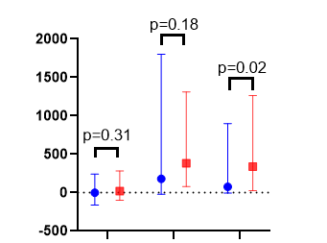
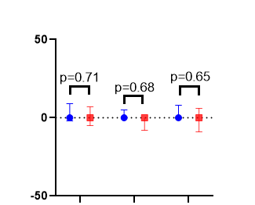
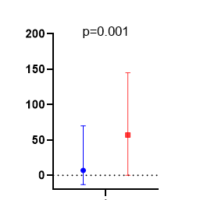
Inflammatory Biomarker Substudy Endpoints
Percent Change in IL-6 Concentration Compared to Baseline (%)
Percent Change in IL-1β Concentration Compared to Baseline (%)
Percent Change in hsCRP Concentration Compared to Baseline (%)
p=0.18
p=0.001
√
p=0.02
√
p=0.71
p=0.68
p=0.65
√
p=0.31
√
√
1
6 to 8
22 to 24
1
6 to 8
22 to 24
22 to 24
Time Post-PCI (hours)
Time Post-PCI (hours)
Time Post-PCI (hours)
#AHA19

Slide 20
Pre-Specified Subgroups
 | n |  | PCI-Related Myocardial Injury
 | Colchicine | Placebo |  |  | p-value
Acute coronary syndrome as indication for PCI | 103 | 95 |  |  | 0.86
No acute coronary syndrome as indication for PCI | 103 | 99 |  |  | 0.13
Presence of an intra-procedural complication | 8 | 10 |  |  | 0.41
Absence of an intra-procedural complication | 198 | 184 |  |  | 0.31
New treatment with high-intensity statin therapy 24 hours to 7 days pre-procedure | 42 | 42 |  |  | 0.54
Stable statin therapy | 164 | 152 |  |  | 0.30
Standardized Difference
-2
0
2
More events with
Colchicine
More events with
Placebo
#AHA19

Slide 21
Adverse Events
 | Colchicine (n=366) | Placebo (n=348)
Chest pain, % | 9.0 | 7.2
Gastrointestinal symptoms, % * | 9.3 | 3.2
Hypersensitivity reaction, % | 1.1 | 1.1
Access site discomfort, % | 1.1 | 1.1
Hemodynamic instability, % * | 0 | 1.4
Fever, % | 0 | 0.6
Elevated creatinine, % | 0.3 | 0.6
Ischemic stroke, % | 0.3 | 0
Fluid overload, % | 0.3 | 0.3
Urinary retention, % | 0.5 | 0
Bleeding, % | 0.3 | 0.6
Palpitations, % | 0 | 0.3
Headache, % | 0.3 | 0
Serious adverse events total, % * | 1.4 | 3.4
* Denotes p-value <0.05
#AHA19

Slide 22
Summary
This investigator-initiated, single-site prospective randomized double-blind study is the first to evaluate the effects of an acute pre-procedural administration of colchicine versus placebo on markers of myocardial injury and inflammation in patients undergoing PCI
Compared with placebo, short-term pre-procedural colchicine:
  Did not reduce PCI-related myocardial injury or MACE at 30 days
  Did attenuate PCI-related increase in IL-6 and hsCRP concentration at 24 hours post-PCI
This is the first study to demonstrate that an oral load of colchicine prevents a rise of inflammatory biomarkers in acute injury.
#AHA19

Slide 23
Limitations
The majority male population enrolled within the VA system limits interpretation for women undergoing PCI.
Observations are limited to
  The selected acute pre-procedural dosing regimen, and
  The short-term timepoints for biomarkers of myocardial injury and inflammation
Genetic data were not collected in the current trial to determine predisposition to colchicine resistance.
#AHA19

Slide 24
We dedicate this study to the memory of Steven Sedlis, MD, Professor of Medicine, consummate mentor, and dedicated physician who devoted his career to improving patient outcomes, educating the next generation of physicians, and advancing science. Dr. Sedlis played a pivotal role with his contributions to both the design and conduct of this trial.
#AHA19

Slide 25
Back-Up Slides

Slide 26
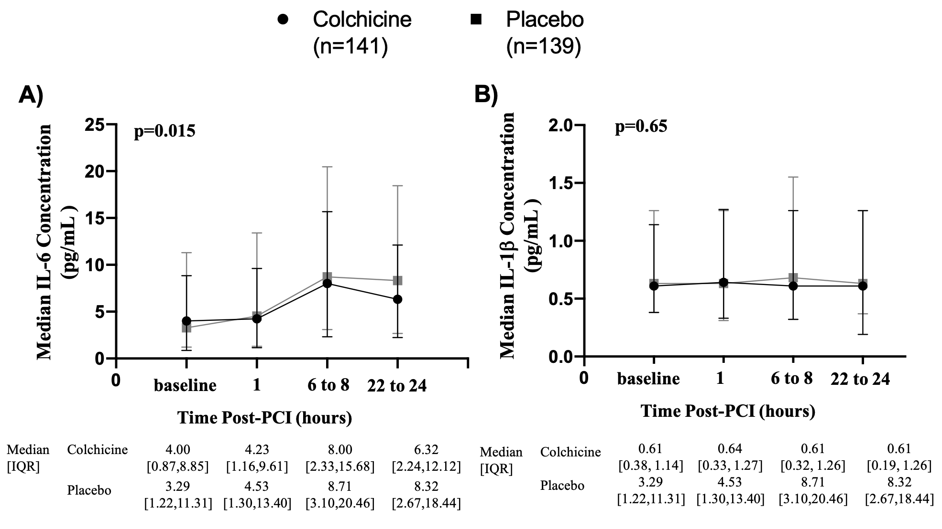
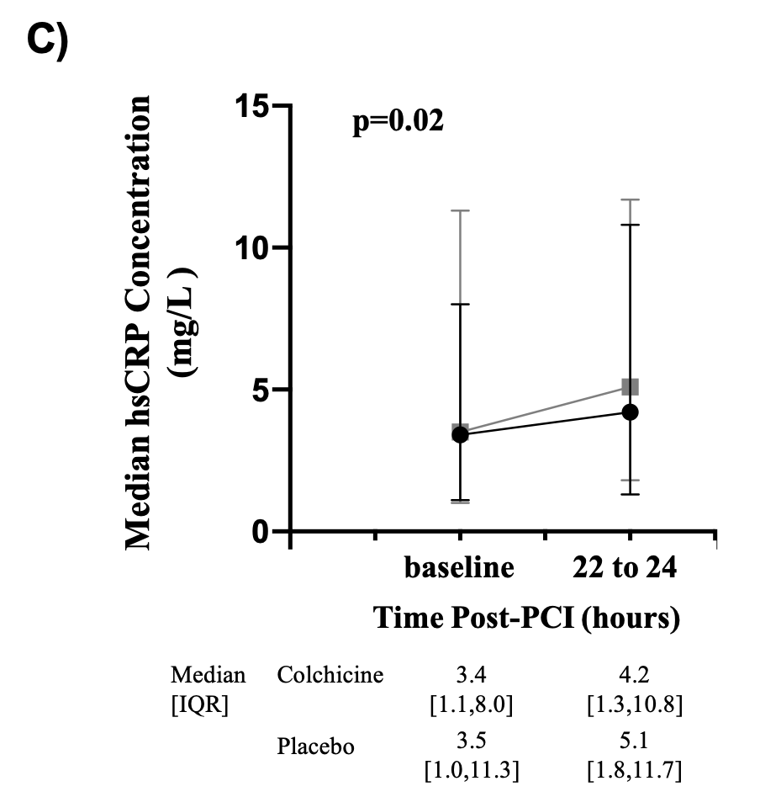
Linear Mixed Model Analysis

Slide 27
Clinical Outcomes by ACS Presentation
 | Colchicine | Placebo | p-value
Subjects with acute coronary syndrome | n=103 | n=95
PCI-related myocardial injury | 57 (55.3) | 53 (57.6) | 0.86
30-day major adverse cardiovascular events | 17 (16.5) | 12 (12.6) | 0.57
Type 4a myocardial infarction (Universal Definition) | 17 (16.5) | 10 (10.9) | 0.35
Type 1 myocardial infarction (Universal Definition) | 0 | 1 (1.1) | 0.48
Target vessel revascularization | 0 | 0 | 0.99
All-cause mortality | 0 | 1 (1.1) | 0.48
PCI-related myocardial infarction (SCAI definition) | 4 (3.9) | 3 (3.3) | 0.99
Subjects without acute coronary syndrome | n=103 | n=99
PCI-related myocardial injury | 61 (59.2) | 69 (70.4) | 0.13
30-day major adverse cardiovascular events | 6 (5.8) | 13 (13.1) | 0.12
Type 4a myocardial infarction (Universal Definition) | 6 (5.8) | 13 (13.3) | 0.12
Type 1 myocardial infarction (Universal Definition) | 0 | 0 | 0.99
Target vessel revascularization | 0 | 0 | 0.99
All-cause mortality | 0 | 0 | 0.99
PCI-related myocardial infarction (SCAI definition) | 2 (1.9) | 6 (6.1) | 0.16

Slide 28
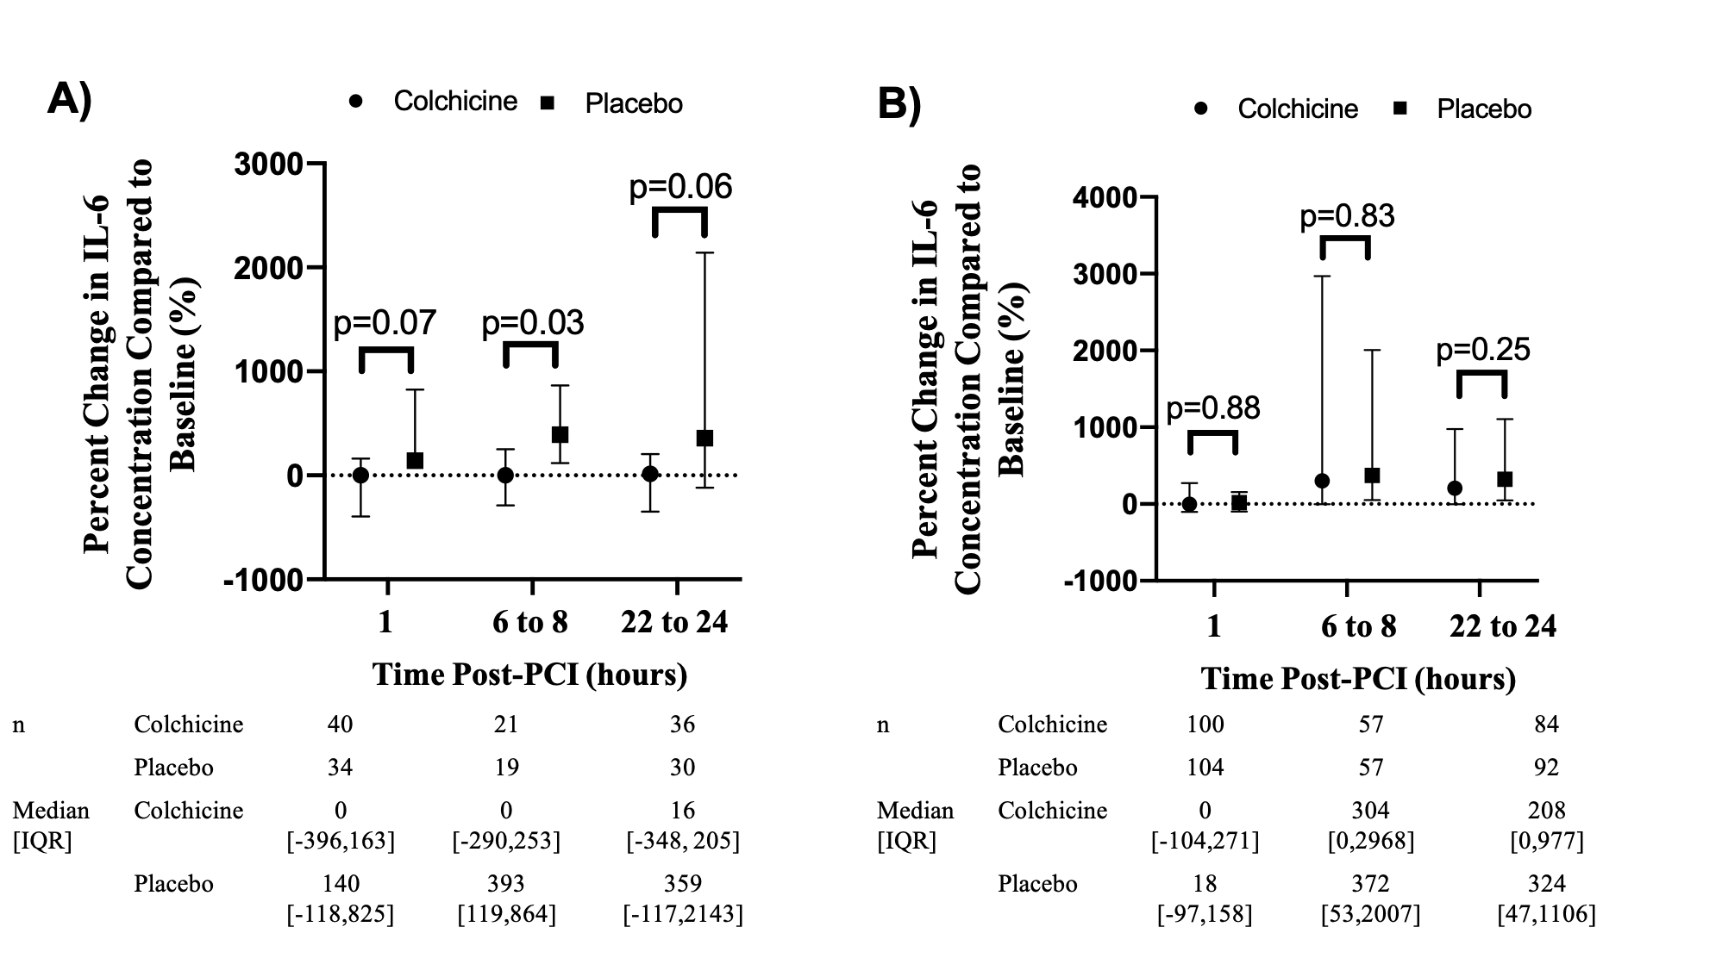
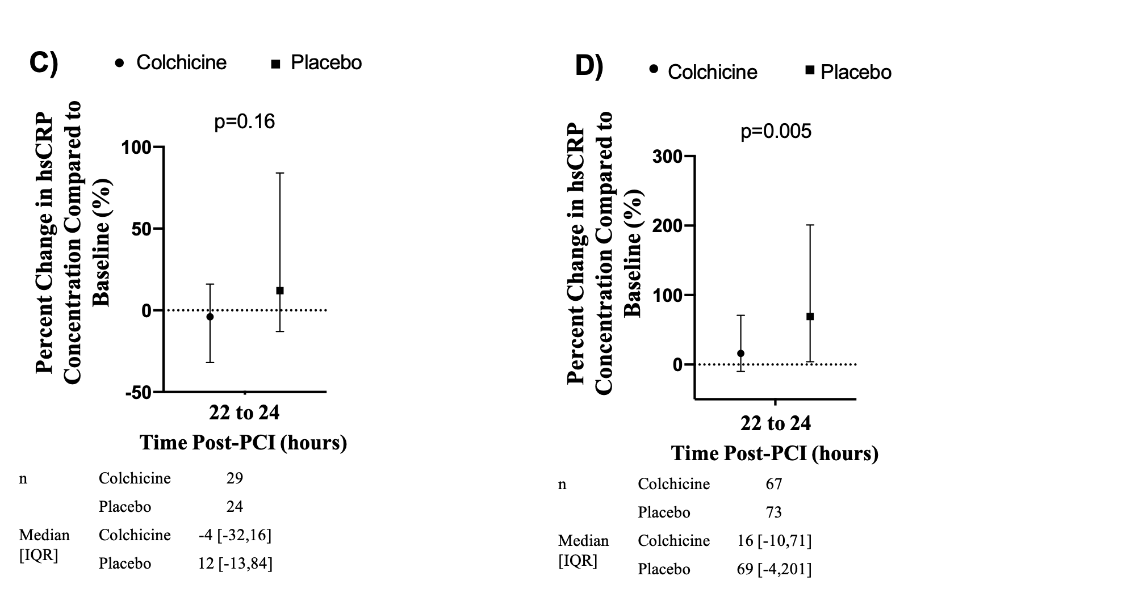
Change in Biomarkers Stratified by Abnormal or Normal Baseline Troponin
Abnormal Baseline Troponin
Normal Baseline Troponin
Abnormal Baseline Troponin
Normal Baseline Troponin

